Slide 1
Introduction
What is CLOUD?
The term Cloud refers to a Network or Internet. In other words, we can say that Cloud is something, which is present at remote location. Cloud can provide services over public and private networks, i.e., WAN, LAN or VPN.
Applications such as e-mail, web conferencing, customer relationship management (CRM) execute on cloud.

Slide 2
Introduction
What is Cloud Computing?
Cloud Computing provides us means by which we can access the applications as utilities over the internet. It allows us to create, configure, and customize the business applications online.
Cloud computing is a model for enabling ubiquitous, convenient, on-demand network access to a shared pool of configurable computing resources (e.g., networks, servers, storage, applications and services) that can be rapidly provisioned and released with minimal management effort or service provider interaction.

Slide 3
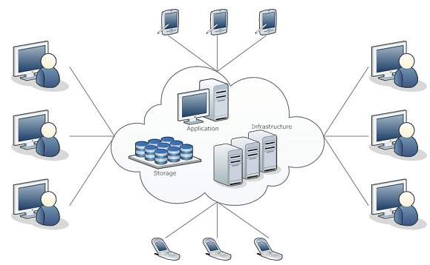
Introduction
What is Cloud Computing?
Cloud Computing refers to manipulating, configuring, and accessing the hardware and software resources remotely. It offers online data storage, infrastructure, and application.

Slide 4
Introduction
Basic Concepts
There are certain services and models working behind the scene making the cloud computing feasible and accessible to end users. Following are the working models for cloud computing:
Deployment Models
Service Models

Slide 5
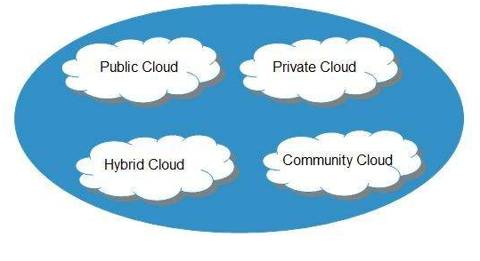
Introduction
Deployment Models
Deployment models define the type of access to the cloud, i.e., how the cloud is located? Cloud can have any of the four types of access: Public, Private, Hybrid, and Community.

Slide 6
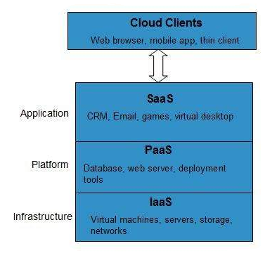
Introduction
Service Models
Cloud computing is based on service models. These are categorized into three basic service models which are -
Infrastructure-as–a-Service (IaaS)
Platform-as-a-Service (PaaS)
Software-as-a-Service (SaaS)

Slide 7
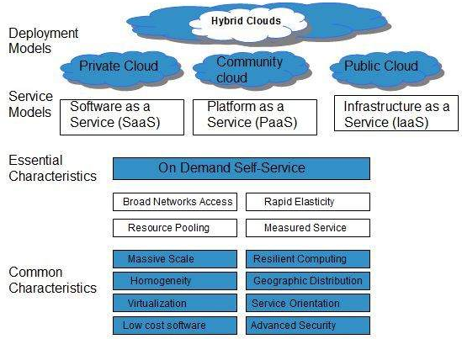
Introduction
Characteristics Of Cloud Computing

